Slide 1
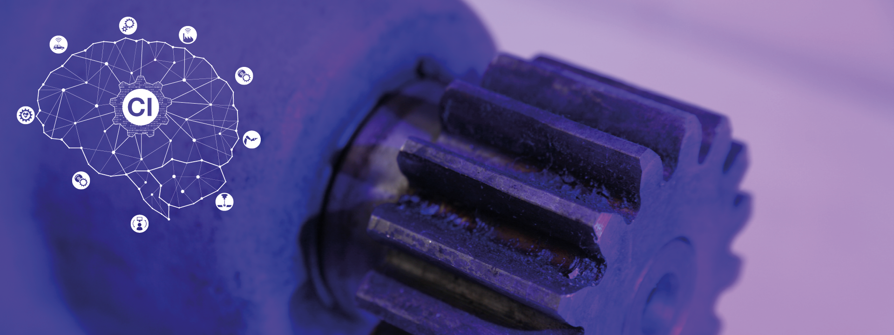
Computational Intelligence in Engineering
Project - B
Group - 17

Slide 2
INTRODUCTION
The Team :
Neural Network model setup and validation - Marcelo
ML model setup and validation - Praveen
Presentation - Abhishek
Agenda :
Project Introduction
Methods
Results and Discussion
Conclusion and Outlook

Slide 3
PROJECT INTRODUCTION
Artificial intelligence solves the challenges posed by data analysis complexity involved in Structural Health Monitoring.
The goal of the project is to see how AI can determine the condition of the structure based on the data provided. This involves evaluating various ML/DL techniques and optimizing it.
The process involves :
Data analysis - Abhishek
Data conditioning - Abhishek, Marcelo
Pre processing - Abhishek, Praveen
Evaluate various AI algorithms with dataset - Marcelo (DL), Praveen (ML)
Optimizing and fine tuning - Marcelo (DL), Praveen (ML)
Validate and estimate parameters - Marcelo (DL), Praveen (ML)

Slide 4
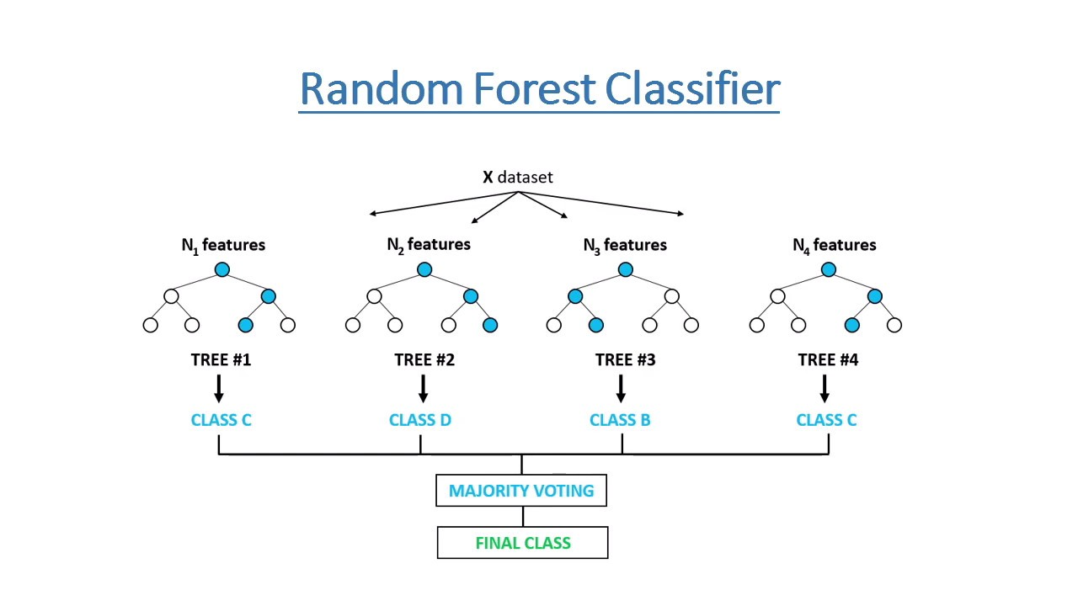
METHODS – ML Approach
Data (Pre-)processing
Data Conditioning (filling missing rows, dropping columns)
Mathematical Stats : Mean, Standard Deviation, min, max
Fast Fourier transform (FFT) (TBD)
Principal Component Analysis (PCA) (5)
Artificial Intelligence
Based on the multivariate dataset, we chose :
Random Forest Classification - accuracy 91%
Picture Source :https://medium.c om/@mrmaster907/introduction-random-forest-classification-by-example-6983d95c7b91

Slide 5
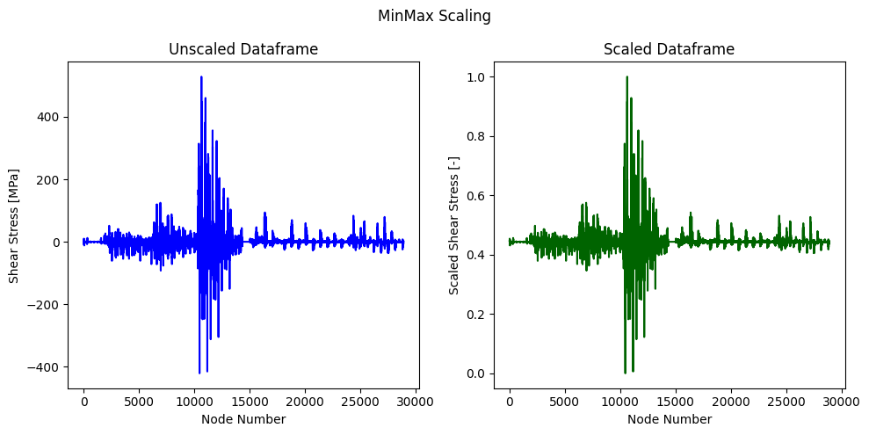
METHODS – ANN Approach
Data (Pre-)processing
Data curing and conditioning (filling missing rows, dropping unnecessary columns).
Selecting relevant data
Scaling data with scipy MinMaxScaler

Slide 6
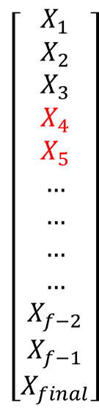
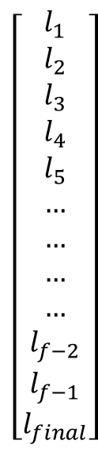
METHODS - Network Architecture - Recurrent neural network
Input tensor: Shear stress YZ as a time series for each node.
We fill the missing nodes with an arbitrary value.
Output: Binary classification value for each node
Masking layer: avoid training with the marked values.
LSTM layer: recurrent NN relu activation - 128 units.
Dense layer: Sigmoid activation
Masking
LSTM
Dense

Slide 7
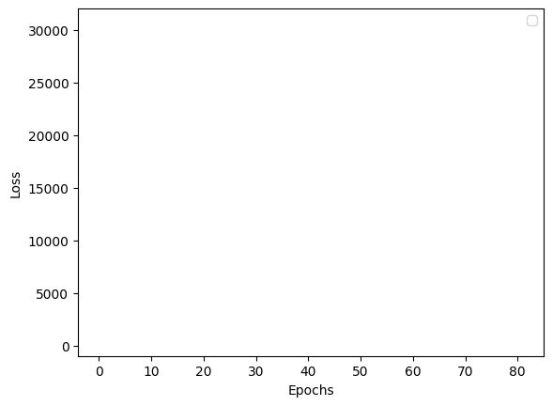
RESULTS AND DISCUSSION - Loss Variation over epochs
Training results

Slide 8
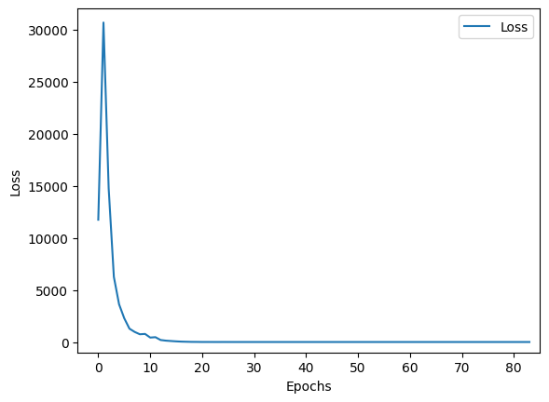
RESULTS AND DISCUSSION - Loss Variation over epochs
Training results

Slide 9
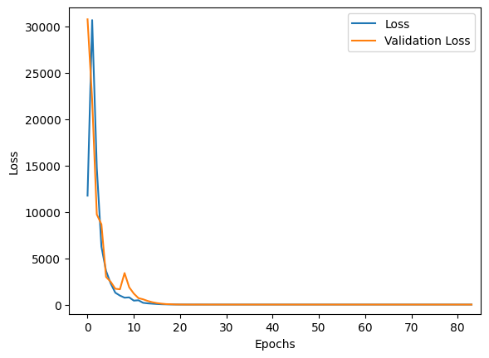
RESULTS AND DISCUSSION - Loss Variation over epochs
Training results
Training results:
No overfitting
Accuracy = 99.9 %
F_score = 96.5 %
Training configuration:
Epochs: 84
Early stopping
Learning rate: 0.01

Slide 10
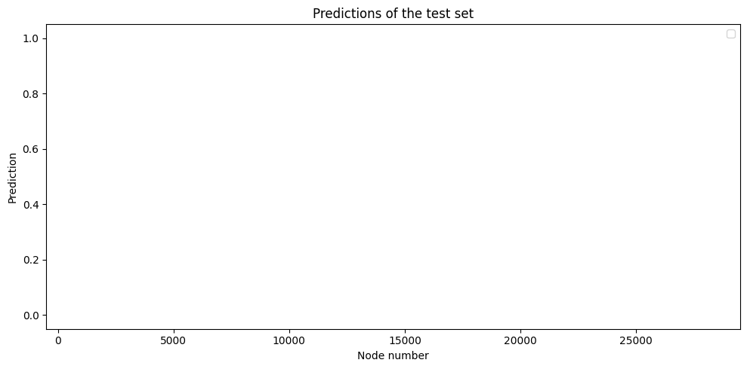
RESULTS AND DISCUSSION - Cross validation
Test dataset was not used in training

Slide 11
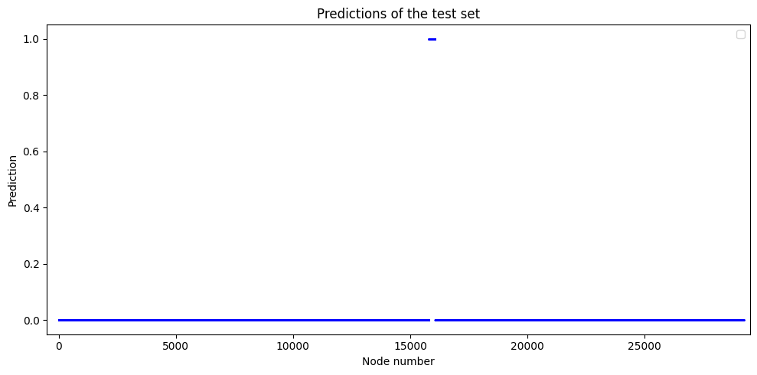
RESULTS AND DISCUSSION - Cross validation
Test dataset was not used in training

Slide 12
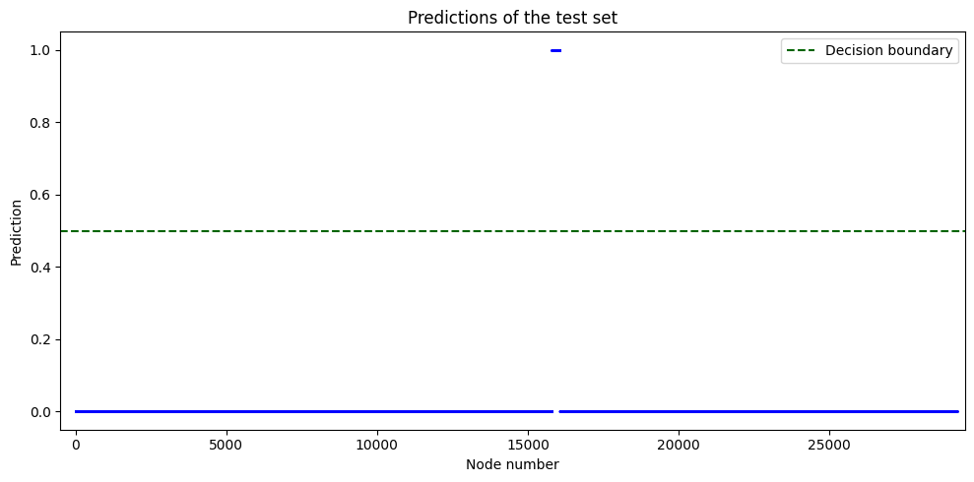
RESULTS AND DISCUSSION - Cross validation
Test dataset was not used in training

Slide 13
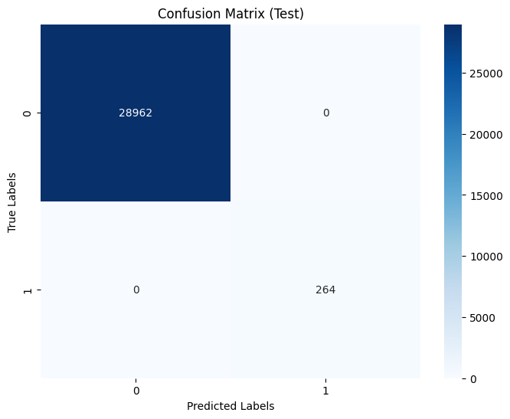
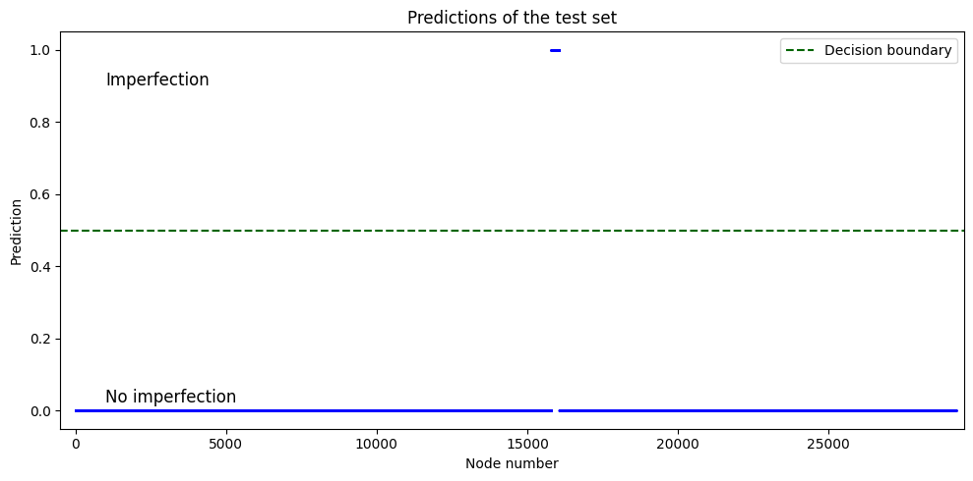
RESULTS AND DISCUSSION - Cross validation
Test dataset was not used in training
No false positives or false negatives

Slide 14
CONCLUSION & OUTLOOK
Conclusion
Different models with both ML and DL approaches were tested.
With complexity of dataset, it makes sense to proceed with LSTM(DL) as it incorporates automatic feature extraction while training as compared to ML methods.
LSTM achieved binary accuracy over 99% in training and validation.
LSTM successfully detected imperfections in the test data.
Outlook:
Further test generalization capabilities of the model using simulations with other types of imperfect dataset.
Expand the LSTM model to use more features.

Slide 15
Thank you for your attention!

Slide 16

Support slides
How does the LSTM recurrent neural network work?
input shape → (batch size, time step, input units) https://www.kaggle.com/code/shivajbd/input-and-output-shape-in-lstm-keras/comments
Network internal architecture
https://colah.github.io/posts/2015-08-Understanding-LSTMs/

Slide 17
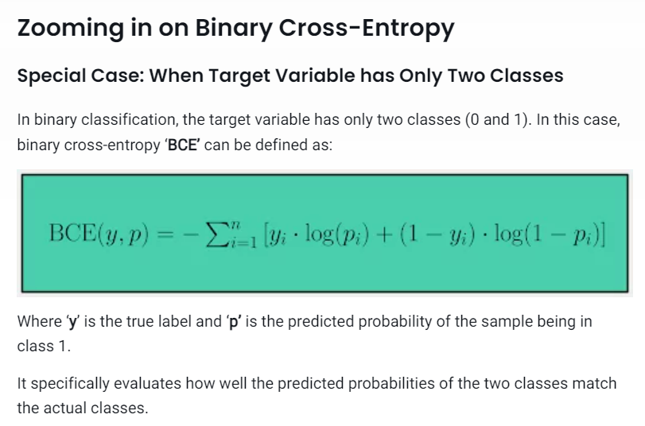
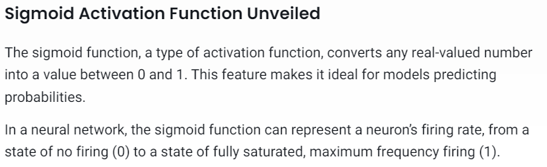
Support slides
Why sigmoid and why binary cross-entropy?
https://www.aporia.com/learn/understanding-binary-cross-entropy-and-log-loss-for-effective-model-monitoring/#:~:text=Probabilistic%20Output%3A%20The%20sigmoid%20function,which%20operates%20on%20predicted%20probabilities.

Slide 18
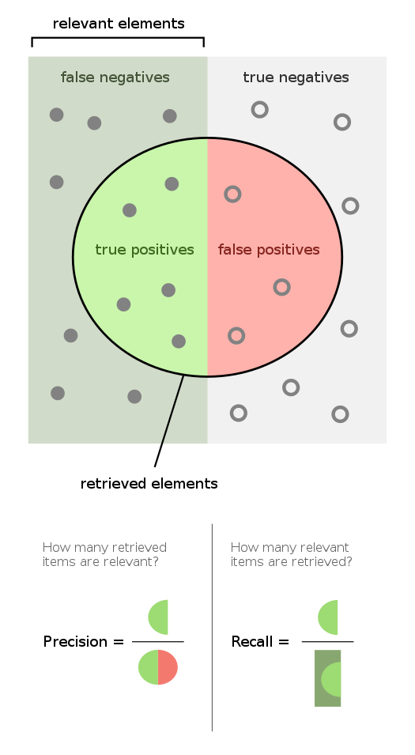

Support slides
F score
https://en.wikipedia.org/wiki/F-score

Slide 19
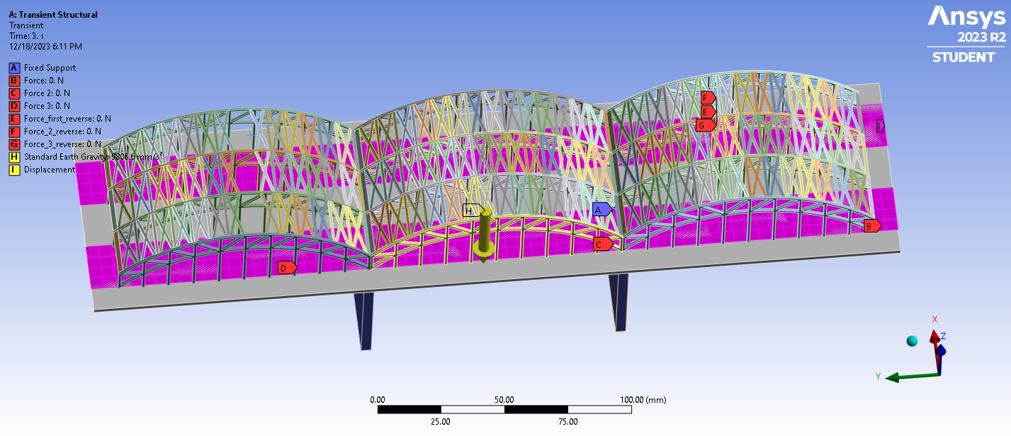
Support slides
Why we chose the shear stress YZ
Dynamic simulation
Force changes magnitude and position depending on the simulation
Complex structure
Elements in very different positions relative to the force
→ Testing with the shear stress YZ provided good results
→ Outlook: Add more features
Source: Image taken from folder: Imperfect Structure, Imperfect no 2_2

Slide 20
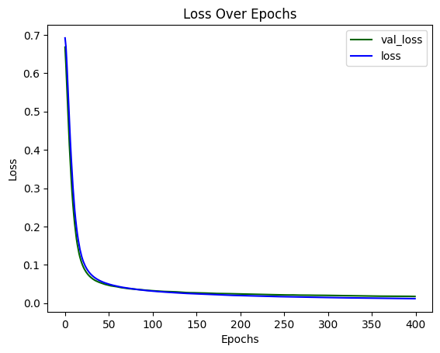
RESULTS AND DISCUSSION - Loss Variation over epochs - tanh
Training results
Training results:
No overfitting
F_score = 0.66
Training configuration:
Epochs: 400
Early stopping
Learning rate: 0.01

Slide 21
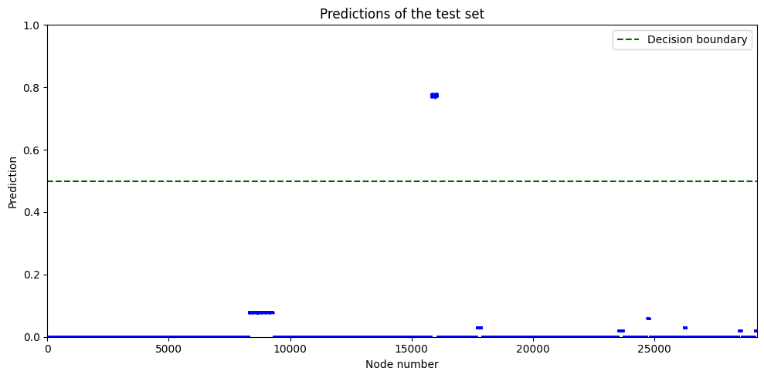
RESULTS AND DISCUSSION - Cross validation - tanh
Test dataset was not used in the training
Imperfection
No imperfection

